Slide 1
We are the CEOs
MEMBERS:
Amanpreet Kaur
Jagriti Popli
Muskan Kalra
Pratibha Goyal
Shikha Khatry
Shubhi Agarwal
05.11.2019
Notes:
The first half of the course was under the umbrella of Economics, while now we are pointing towards finance, which talks about corporates and businesses which comprises of us, the future CEOs

Slide 2
WHY ARE WE TALKING ABOUT CEO’S?
Notes:
When sir wishes good morning in class that means, we are in the first minute of the next 24 hours similarly, not some but most of us are treading onwards the first mile of the road to become a CEO. Somebody who is capable to juggle hats between the 6 hats as architect, engineer, coach, player, priest and can befriend the 5 uncommon friends

Slide 3

How to learn to be a GOOD CEO?
HOME
Curriculars
Extracurriculars
Organisation
Globally
Observe and absorb!
Notes:
So, here’s the pentagon we stand at the centre of. Which holds various phases and experiences of the life, the chapters of learning to observe and absorb from.
The goal is to buy the costliest thing to a CEO i.e sound sleep
Various chapters of learning

Slide 4

Mother as the most natural CEO
M O M
Master Of Multitasking
Switch roles and juggle hats
Skills without certificates
Perfection without rewards
Home-org growth matters
Never complacent
Never complains
Notes:
MOM here is the main protagonist. No praise to grow.
Thinking of a mother as a CEO adds to her credibility as a highly significant worker in our world. Manages money without a finance degree, manages This slide is meant to applaud her functions which she never does on her own.

Slide 5
SCHOOLS AND COLLEGES

Slide 6

In this Phase of life, we are the role models as a Senior.
Qualities to be future CEOs :
Organized and High moral character
Emotional Intelligence
Persistence
Vision of excellence.
Self-awareness and psychological maturity
Notes:
In every phase of our life we are the role models to some or the other like at home we are role models to our siblings, in college or schools we are role models to our juniors and future in life we will be role models to many others as a Successful CEOs.
What all qualities we should have to become successful CEO of future
Organized and high moral character - being organised seems very basic but effective, being successful we need to be highly organized; improper work; management of time and dividing it according to the priority. Apart from this ethical decision making is necessary. ethical(consulting colleagues, accepting our mistakes and being honest to others)
Emotional Intelligence :

Slide 7
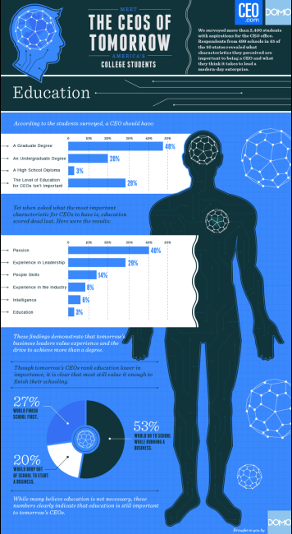
According to “CEOs of Tomorrow’s America’s College Students” survey:
CEO’s primary characteristics should be “EDUCATION”
Yet in reality, it is scored dead last.
Successful CEO = Decisiveness + Confidence + Reliability + Adaptability + Success.

Slide 8
EXTRA CURRICULARS

Slide 9
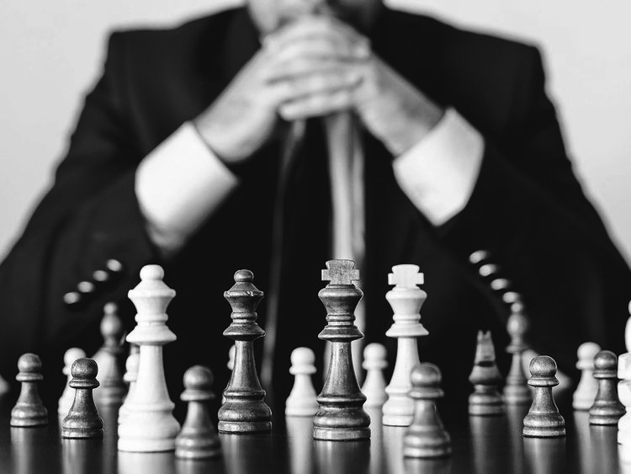
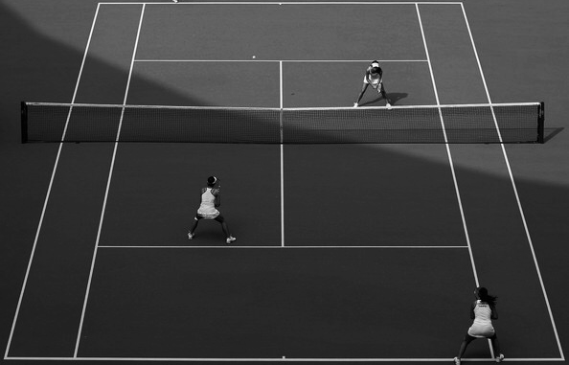
Chess :
CEO is one of the Grand-master.
Grand-master works in a time constraint.
Should foresee 2-3 moves ahead.
Pressure sharpens their mind.
Tennis :
A person can master with one player.
Playing with 2 players.
Response is coming much faster.
More accuracy and precision req.

Slide 10
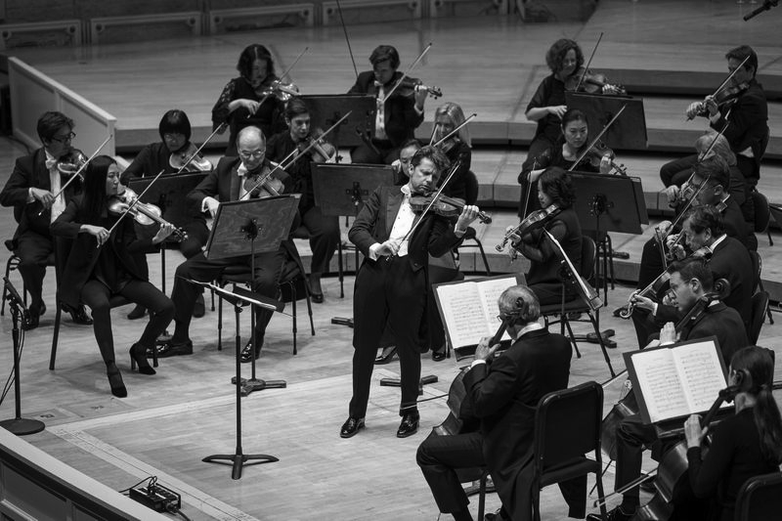
Orchestra :
Orchestra master is the conductor of Orchestra like a CEO is a magician of a company.
Collective music is what we are trying to bring.
Optimization is the ultimate goal.

Slide 11
Takeaways from real world role models

Slide 12
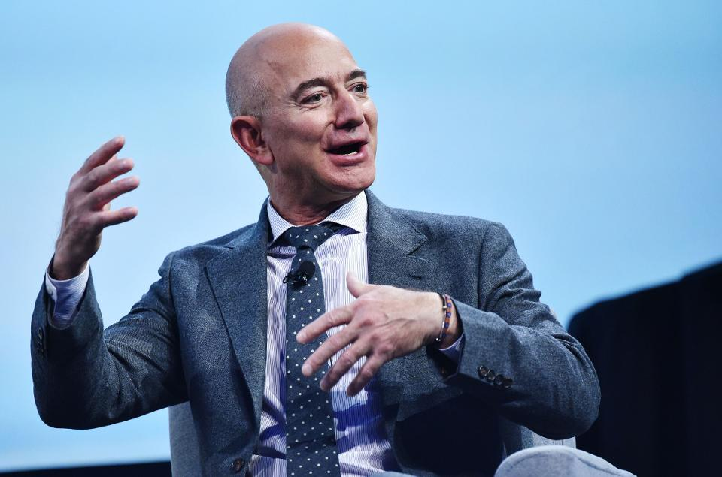
Jeff Bezos - Amazon CEO
Amazon is the 5th most valuable firm.
Worth $400bn, 70% higher than Walmart.
These stats are insane- MADability.
Notes:
There'll always be serendipity involved in discovery. – Jeff Bezos and accounts for more than half of every new dollar spent online in America. How did they do this? They serviced the forgotten customer.

Slide 13
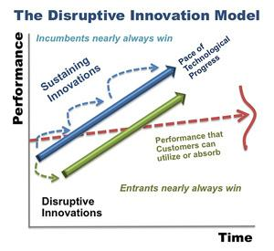
The secret to their sauce lies in what Harvard Business School professor, Clay Christensen calls ‘disruptive innovation’.

Slide 14
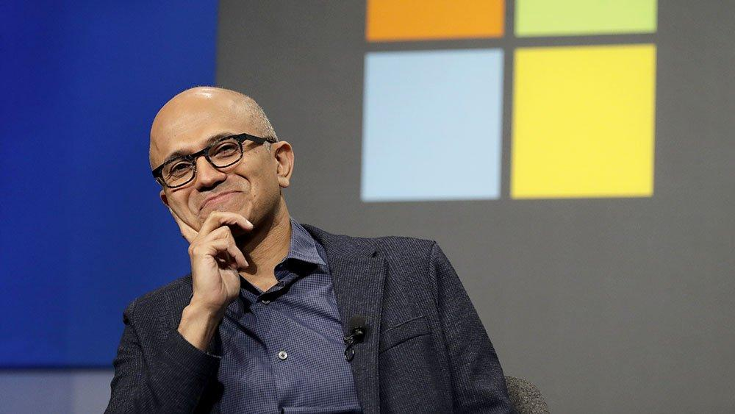
Satya Nadella - Microsoft

Slide 15
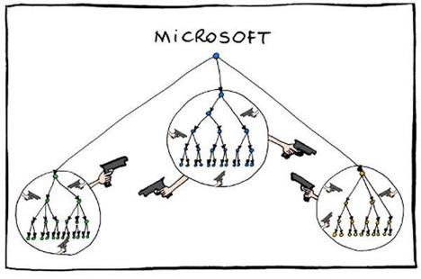
Satya brought about a change by changing the culture at Microsoft!
2011, Manu Cornet
In Satya’s Microsoft there are only “fixers” and no “complainers”.
Notes:
https://qz.com/work/1539071/how-microsoft-ceo-satya-nadella-rebuilt-the-company-culture/

Slide 16
Embracing a Growth Mindset
Nadella credits Dweck’s 2007 book Mindset: The New Psychology of Success with defining his philosophy on company culture.
But as much as growth mindset is about innovation, it is also about learning from mistakes.
The beauty of the growth mindset, though, is that you can let a mistake become a learning opportunity.

Slide 17

“The cure for Apple is not cost-cutting. The cure for Apple is to innovate its way out of its current predicament.” - Steve Jobs

Slide 18
WHAT’S KEEPING CEOs LATE UP AT NIGHT ?

Slide 19
Issues
Ability to operate in a global marketplace
Political uncertainty and legislation
Able to capitalise on emerging technologies in a timely manner
Talent related issues.
Notes:
The challenge may be currency and economic volatility, extended supply chains, local competition or maintaining the culture when people are operating a long way from the home-base.This is about ensuring that local employees can truly connect with the organisation, and that the policies and processes reflect the world within which you operate, and not just that of your home-base.
Without doubt we are operating in uncertain times. The political landscape is changing at home and abroad which is impacting upon international trade and supply chains. Right now, the rate of technological change is the fastest it has ever been, and it will continue to increase. For fast-moving organisations, this presents a great opportunity followed by challenges
There isn’t a single business or sector that is safe from disruption. There were numerous hoteliers and taxi drivers who said things like:“Technology won’t affect us, people will always need a place to stay in or need to get from A to B in a taxi.”And then along came Air B&B and Uber. So organizations have to expand their horizon again and again . CEOS need to stay current and connected with the world. Its not important to be the first organization who exploit the new technology but to be someone who have increased value foe customers using this new technology They also have to ensure that they have the talent within organisations to exploit the new technologies and associated opportunities..For example if we talk about blockchain most employes of the company dont even know what the technology does .
Attracting, developing and retaining talent has been on CEOs’ ‘worry list’ for decades. Yet it’s often the one that receives the least focused attention from the executive team.
So concluding all these issues basically ceos believe that they must have all of the answers. They believe that asking their team for help is a sign weakness. So successful leadership is not about being all-knowing and all-conquering. The success of our team or business does not depend on ceos ideas alone . it depends on the entire team

Slide 20
CONCLUSION
FIRST WE NEED TO BE CEOs’ OF OURSELVES

Slide 21
What we need ?
Passion
CEO is passionate for their company.
Don’t give up, give 100%, no show off, no excuses.
Similarly we should be passionate for whatever we do.
Vision
CEO’s have steering wheel of their business, plan for the next 5-10 years in advance.
Same is required in our life as well.

Slide 22
Able to handle pressure
To run a company, deal with its day-to-day issues, keep up with the success.
We should also learn how to deal with pressure.
Multitasking
At a CEO level life is so hectic,fast paced and competitive.
We should also learn to juggle between things. Eg. Mothers

Slide 23
Growth Mindset
Great minds always seek for improvement ,never satisfied.
We should also look for better versions of ourselves every day.
Curiosity
Curiosity inspire them to seek out fresh ideas.
We should also be curious, full of questions.
Curious minds are always great learners.

Slide 24
References
To visit:
https://ceoworld.biz/2019/05/10/whats-keeping-ceos-up-at-night/
https://entrepreneurshandbook.co/8-famous-theories-every-ceo-should-know-about-how-to-manage-a-company-c4e3e
https://www.business2community.com/leadership/ceos-can-encounter-problems-confidence-turns-arrogance-01709956
https://brandongaille.com/the-leadership-qualities-the-future-ceo/
Don’t visit:
https://www.aventr.com/blog/the-6-best-and-worse-ceos-of-2017-and-what-you-can-learn-from-them

Slide 25

DEDICATED TO

